Slide 1


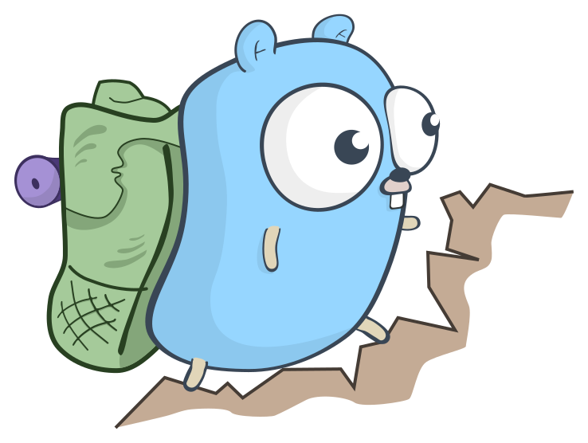

Concurrency in Golang
Persuasion to use Go in your next project
Zach Croft

Slide 2

Credits

Slide 3
Overview
Intro to Golang structure and syntax
Concurrency vs. parallelism
Communicating Sequential Processes (CSP)
Threads, coroutines, and goroutines *
Go’s sync package (traditional memory synchronization)
Go’s channel and channel patterns (CSP-style memory synchronization) *
Go’s context package
Go’s synctest package (new August 2025) *
Why should a Ruby developer care?
Not planning on directly discussing (but some info is in the book for 1-3):
Details of the “Communicating Sequential Processes” paper or CSP language syntax
Examples and solutions to deadlocks, livelocks, and starvation
Go runtime internals (particularly how goroutines are scheduled and channels work)
Ruby’s threads or Global Interpreter Lock (feel free to add input, but I didn’t research these much)

Slide 4
Intro to Go
Go is compiled, statically typed, and is exclusively garbage collected.
Unless you use the “unsafe” package in Go stdlib, to use malloc and free through invoking C.
Go reverses typical syntax (int x = 3) to (var x int = 3)
Go is not object oriented. Structs like C.
To note in VSCode:
packages/modules
Building/executing a binary
Syntax:
Variables, pointers, functions, receivers, arrays/slices
Access modifiers, first class functions, duck typing/interfaces
… To VSCode
Notes:
go build -o main main.go vs go run main.go

Slide 5
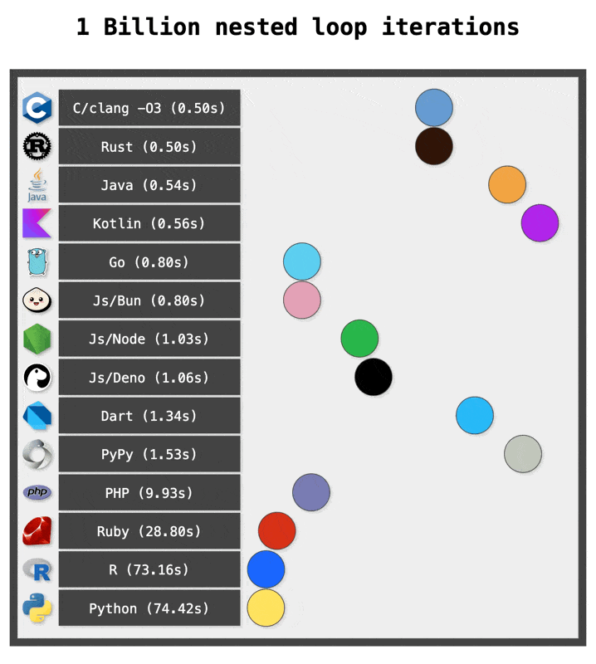
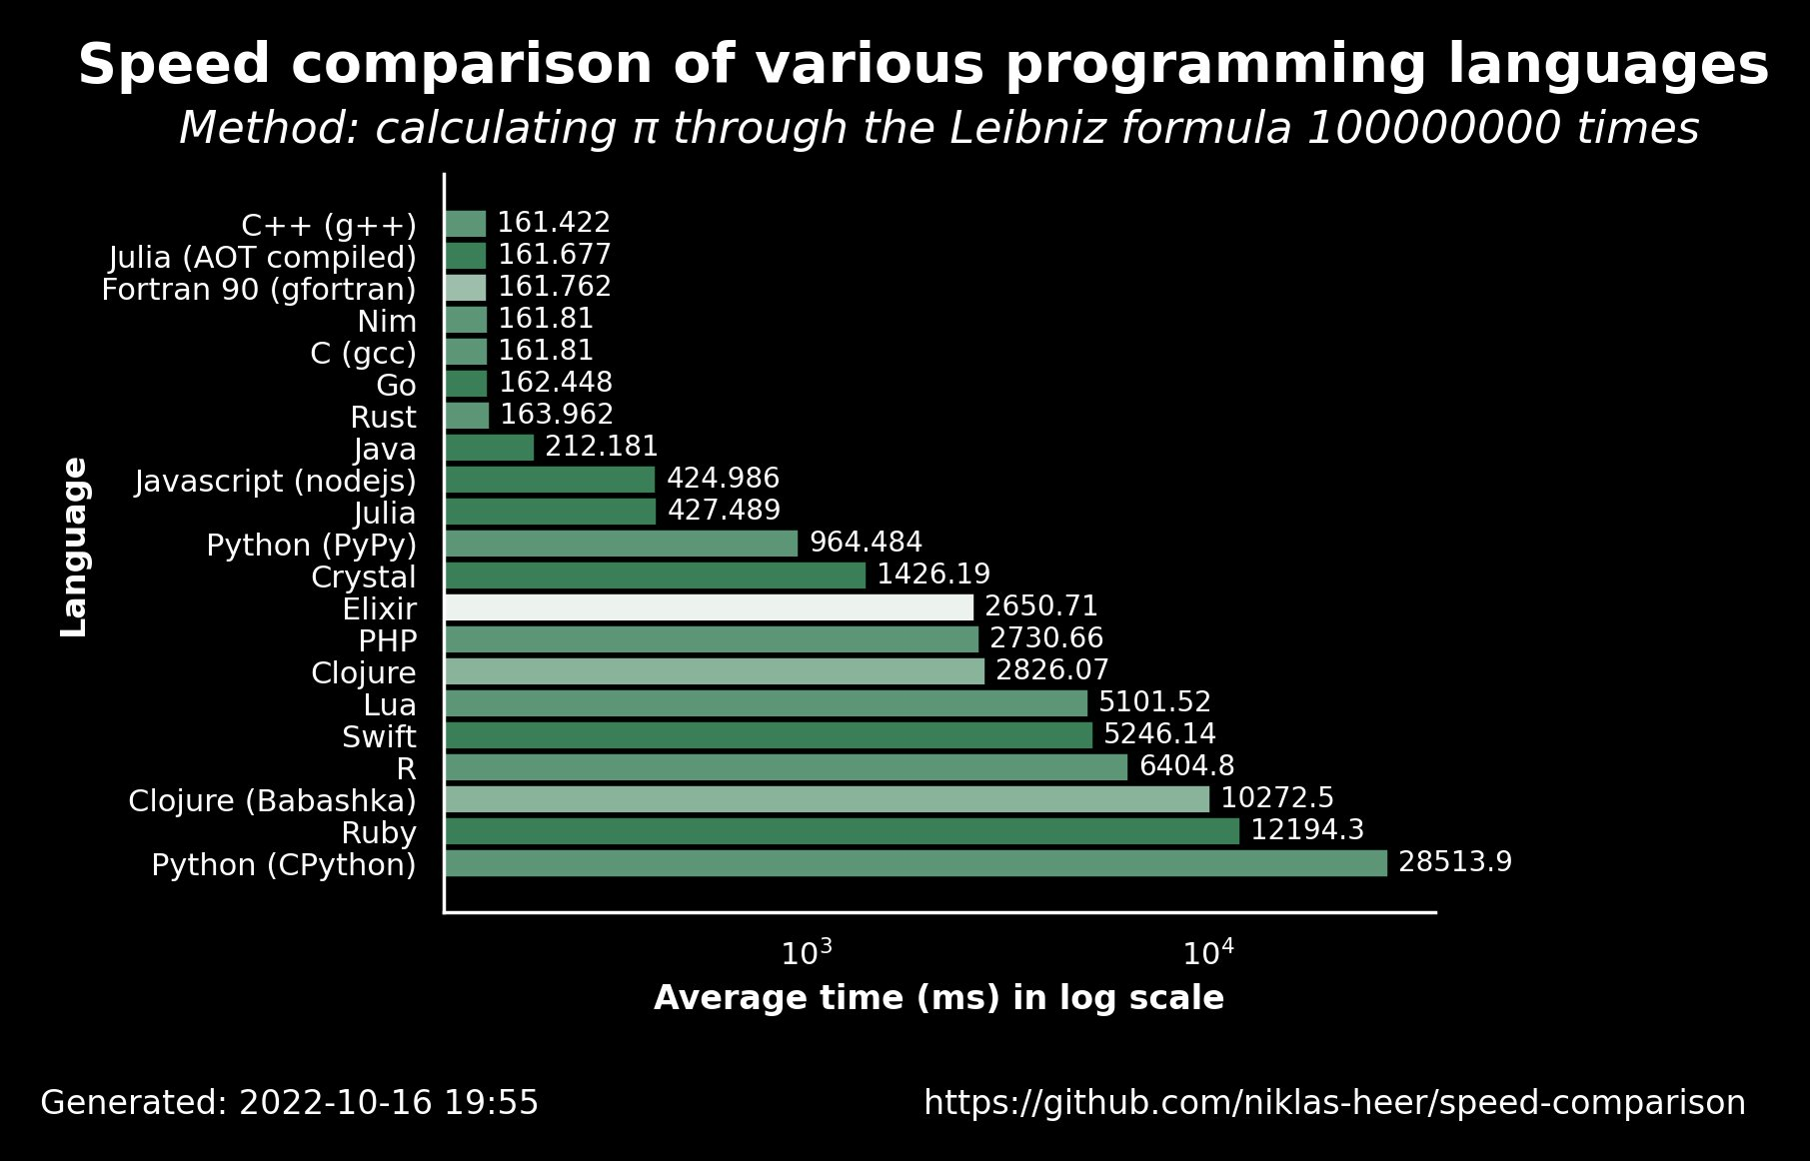
Speed
While many benchmarks are often iffy because of unfair comparisons or unusual circumstances, Go tends to land slightly slower than Rust/C/C++, but much faster than Java, Python, Ruby, JavaScript, etc.

Slide 6
Concurrency vs Parallelism
“Concurrency is a property of the code; parallelism is a property of the running program.”
Parallelism: tasks being run at the same time, across multiple cores/processors.
Concurrency: tasks being structured to run simultaneously, whether they do or not.
Concurrent tasks on one core are alternated between rapidly, appearing simultaneous, but are really sequential (time-slicing: preemptive multitasking by CPU, giving each process fixed-length turns).
Concurrent code can be parallel, but doesn’t have to be.

Slide 7
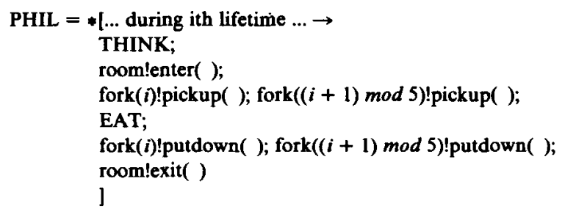
“Communicating Sequential Processes” (CSP)
Title of an ACM paper written in 1978 by Charles Antony Richard Hoare.
Formal language for describing patterns of interaction in concurrent systems.
Emphasizes that concurrent processes (or functions) should be pure–no synchronized global state, all data is managed through I/O passed between processes.
Based on message passing via channels, which became popular in distributed systems.
Why should you care?
CSP-style code, while sometimes long, is easy to reason about and typically safe.
* We will come back to this at the end, to handle hungry philosophers.
CSP directly inspired Go’s channels and select statement.
“Don't communicate by sharing memory; share memory by communicating.”
<- Snippet of (intentionally buggy) CSP code from the paper

Slide 8
Threads, coroutines, and goroutines
OS/kernel threads are 1:1 with hardware cores.
12 cores means 12 tasks can be worked on in parallel.
Many programming languages support threads. These are not necessarily 1:1 with kernel threads.
Native threads are 1:1 with OS threads. (e.g. POSIX threads in C).
Heavy memory consumption, OS manages scheduling, and slow context switches.
Green threads are M:N (M language threads mapped to N OS threads), and the language runtime manages scheduling between language threads.
Coroutines:
Concurrency in Go defines coroutines as: “Concurrent subroutines that are non-preemptive…with multiple points throughout which allow for suspension or reentry.”
Similar to green threads: lightweight user-space constructs managed by runtime.
Difference lies in scheduling:
Green threads are preempted by the runtime.
Coroutines are based on cooperative scheduling, voluntarily giving up control at specific yield points.
e.g. async/await in JavaScript.
Notes:
Process vs Thread:
Process is like the execution of a program, thread is a subset of a process. Processes offer an abstraction–virtualization–for isolation, security, giving virtual address space, file descriptors, memory, etc. to threads within it. Threads and processes are both made up of task_struct in linux source code, (PID, file descriptors, state, scheduling info, etc) and only differ in what is shared between them. Processes by default don’t share unless interprocess communication is established.
Threads are lightweight, and offer multithreaded experience. This introduces race conditions, deadlocks, etc. and can be mitigated using locking techniques. Context switching between threads is slow. Threads have their own stacks but share a heap, etc.
Threads share heap, file descriptors, process ID, etc.
Threads don’t share stack, TLS = thread local storage, thread ID, registers and CPU state, etc.
Kernel keeps track of context of tasks.

Slide 9
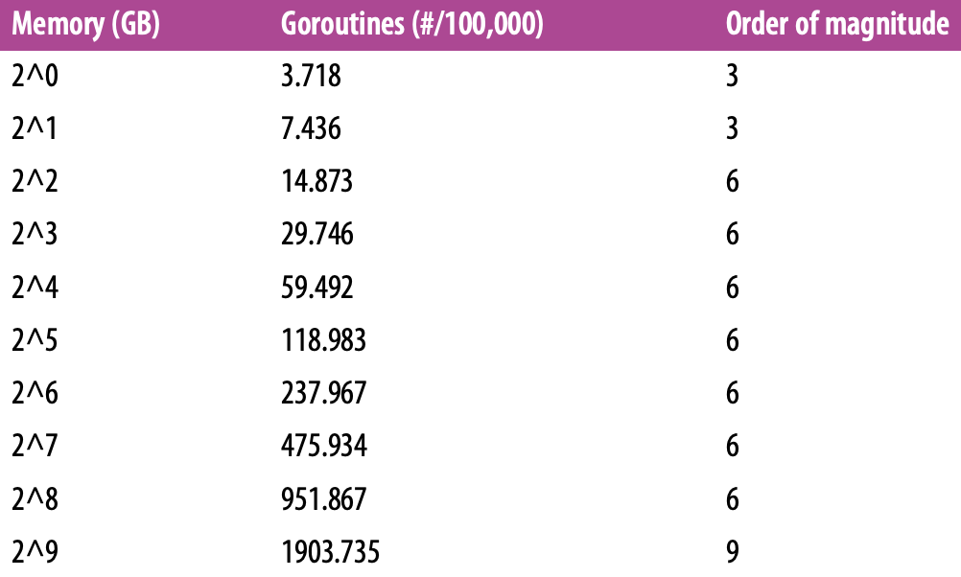
Goroutines
Goroutines are unique to Go. They are a hybrid between green threads and coroutines.
Goroutines don’t define their own suspension or reentry points; Go’s runtime observes the runtime behavior and automatically suspends and resumes when blocked and unblocked.
Very lightweight (10k empty goroutines ~ 2.8 kb in memory).
Native threads would be GBs of memory.
Context switch in Go runtime is ~92% faster than OS context switch (benchmark in book).
There is always at least one goroutine (the main goroutine).
… To VSCode

Slide 10
sync package
WaitGroup (seen during goroutines)
Concurrent-safe counter
Calls to Add(n) increment the counter by n, and calls to Done decrement by 1.
Calls to Wait block until the counter is zero.
Mutex (Mutual exclusion) and RWMutex (Read/Write mutex)
Both Mutex and RWMutex the ‘sync.Locker’ interface: Lock(), Unlock()
defer lock.Unlock() to protect from deadlocking when panicking in a critical section.
RWMutex allows any # of goroutines to acquire a read lock, only while no write lock is held.
“Regarding mutexes, the sync package implements them, but we hope Go programming style will encourage people to try higher-level techniques. In particular, consider structuring your program so that only one goroutine at a time is ever responsible for a particular piece of data.”

Slide 11
sync package (continued)
Cond
A rendezvous point for goroutines waiting for or announcing the occurrence of an event.
Goroutines can efficiently sleep until signaled to wake and check their condition.
… To VSCode
Not going to show a code example for time’s sake, but there is also a Broadcast() function on Cond. It allows a publish-subscribe pattern where all listeners can unblock.
This may prompt you to ask, if multiple goroutines are blocking on c.Wait() and another goroutine calls c.Signal(), what happens?
The runtime has a FIFO list of wait times and notifies the longest-waiting goroutine.

Slide 12
sync package (continued, again)
sync.Once
sync.Pool
“concurrent-safe implementation of the object pool pattern”
… To VSCode

Slide 13
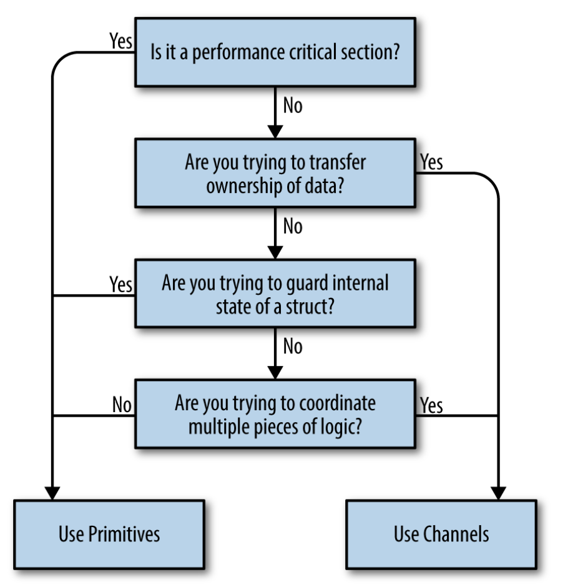
Channels
Derived from CSP, to communicate info between goroutines, like a stream.
For sake of time, skipping details of channels.
Send values with ‘channelVariable <- value’ operator.
Read values with ‘value <- channelVariable’ operator.
… To VSCode until patterns

Slide 14
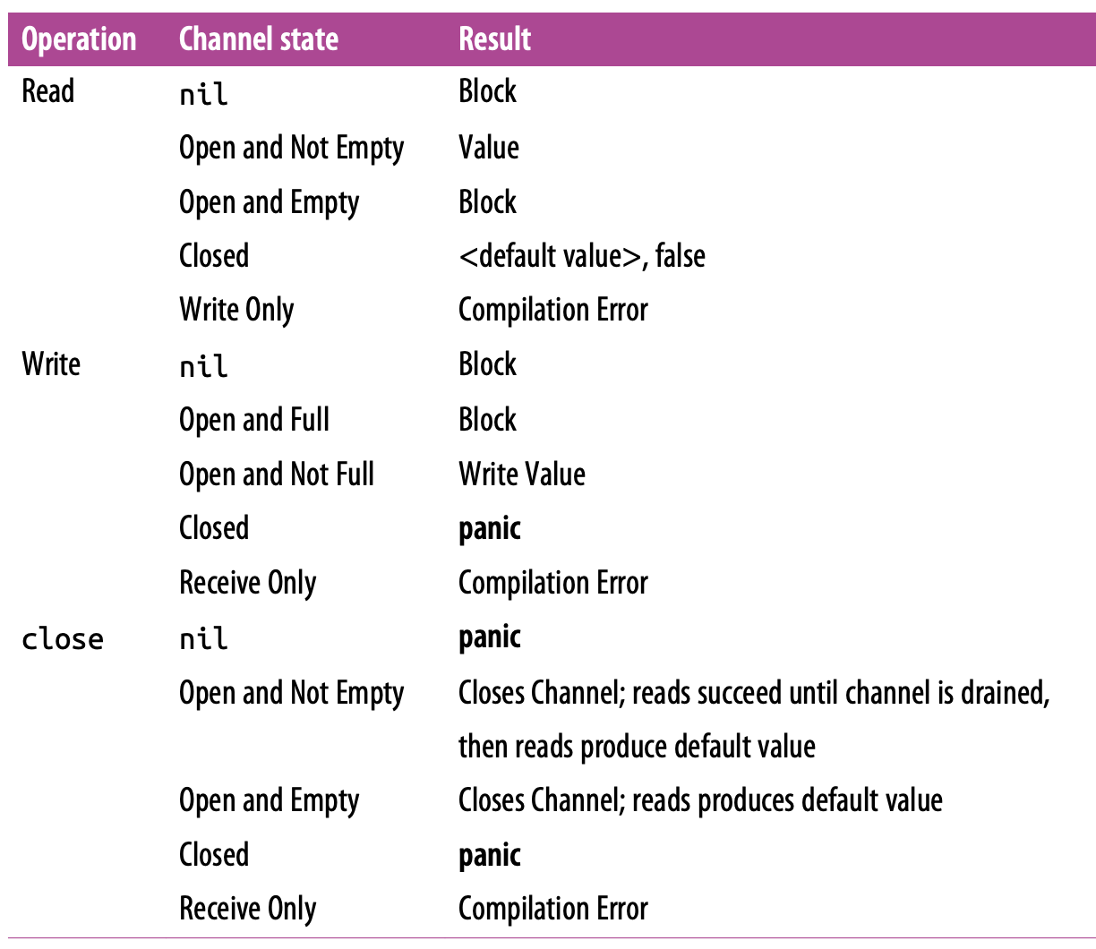
Channels and Channel Patterns
Channels seem frightening–they can cause blocking, compilation errors, and panics all over.
Assign channel ownership to limit this (confinement).
Confinement/Ownership:
1. Instantiate the channel.
2. Perform writes, or pass ownership to another goroutine.
3. Close the channel.
4. Encapsulate the previous three things in this list and expose them via a reader channel.

Slide 15
Channel Patterns
Confinement (ownership) pattern
For-select pattern
Done channel pattern
Read-only channel to signal goroutines to stop their work.
Convention is to have ‘<- done’ as the last channel in a select statement.
The or-channel (the coolest part of this presentation)
Multiplex data from n channels onto a single notification channel.
If you can’t know how many channels you will be reading from at runtime, pass a variadic slice of channels to the or function to return an or-channel.
Fan-out, fan-in (omitting example code)
Multiplex data from n channels onto a single data channel, similar to or-channel.
Tee-channel
Like tee command in bash (split input into two outputs):
alias testsuite='RAILS_ENV=test bundle exec rake test:parallel | tee testrun.log'

Slide 16
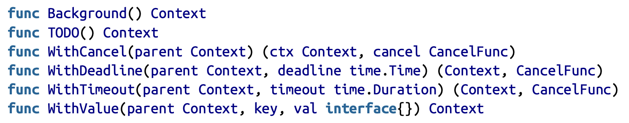
Channels and context package
Wraps a ‘done’ channel in additional information, for the life of a request.
Controller -> Model -> Repository layer
Pass context through each layer, creating sub-contexts for differing behavior.
Select on ctx.Done() (Done() returns a done channel) in all layers
Example:
Controller: ctx := context.Background() // new, empty context, pass into model
Model: ctxWithDeadline := context.WithDeadline(ctx, 2 * time.Second)
Pass the context with a deadline to the repository layer.
The repository layer selects on the done channel, and will abort after 2 second timeout.

Slide 17
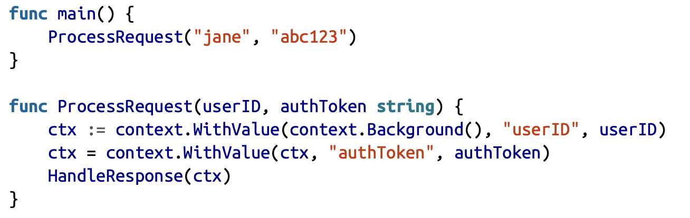
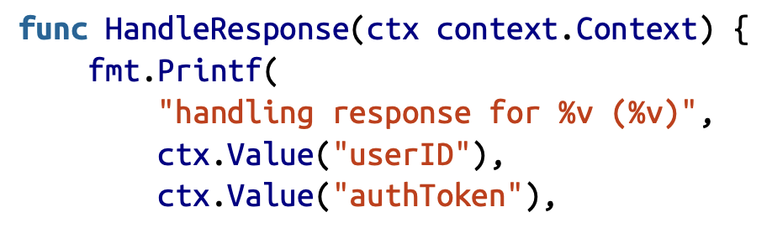
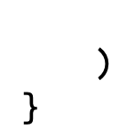
Channels and context package (continued)
Controversial: context.WithValue(parent Context, key any , val any) Context
An arbitrary grab-bag of untyped data (ahhhh scary).

Slide 18
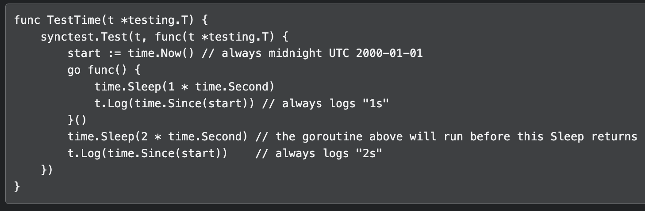
synctest (New in Go 1.25, 9/3/2025)
Ok, big deal. We can write concurrent code, but can we test it?
synctest creates “bubbles” and any goroutines started within the bubble are also part of the it.
Within a bubble, the time package uses a fake clock. Each bubble has its own clock. The initial time is midnight UTC 2000-01-01.

Slide 19
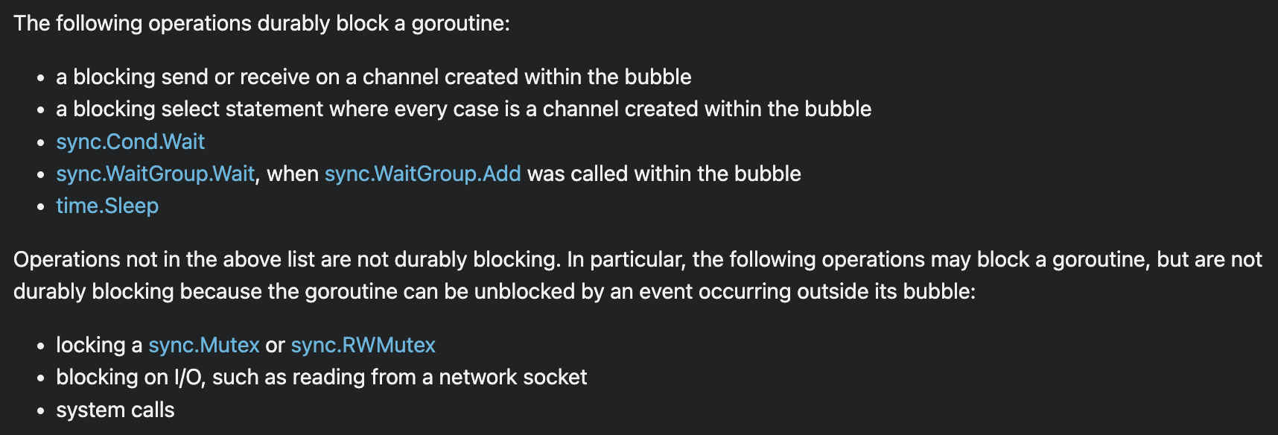
synctest (New in Go 1.25, 9/3/2025) (continued)
A goroutine in a bubble is "durably blocked" when it is blocked and can only be unblocked by another goroutine in the same bubble.
A goroutine which can be unblocked by an event from outside its bubble is not durably blocked.
The Wait function blocks until all other goroutines in the bubble are durably blocked.
A few specific operations unblock a durably blocked goroutine.

Slide 20
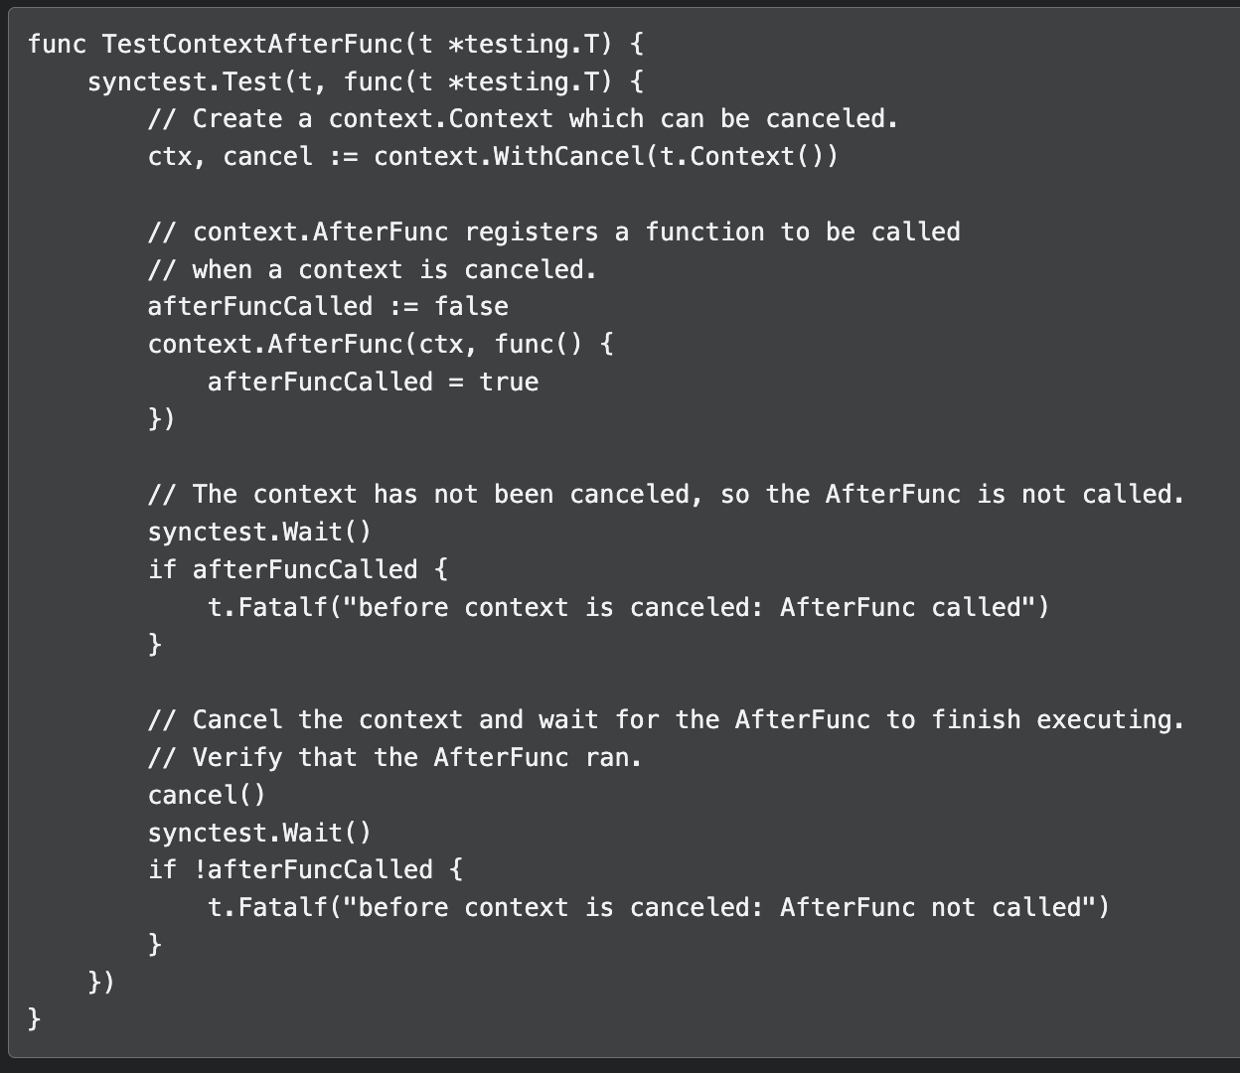
synctest (New in Go 1.25, 9/3/2025) (continued)
https://pkg.go.dev/testing/synctest
https://victoriametrics.com/blog/go-synctest/
https://www.youtube.com/watch?v=1ZlcsgkOvCk

Slide 21
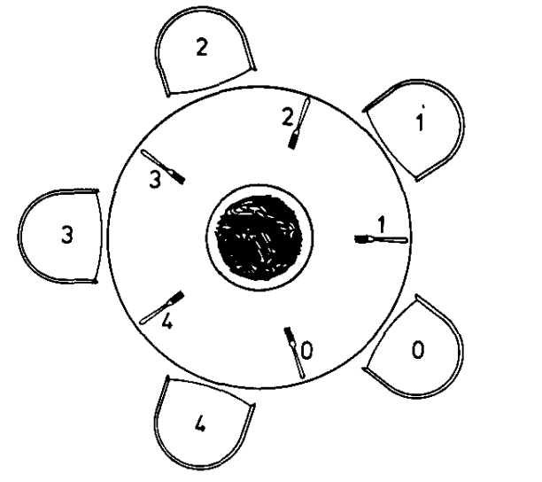
Dining Philosophers: The Return of CSP
5 philosophers sit around a table with 5 forks (one between each pair). Each philosopher alternates between thinking and eating.
Philosophers are very hungry and want two forks to eat!
To eat, a philosopher needs both adjacent forks (left and right).
The Challenge: How do they coordinate without:
Deadlock - all grab left fork, wait forever for right fork?
Starvation - some philosopher never gets to eat?
Simple representation:
Have 5 total forks, and grant 2 at a time to a philosopher.
… To VSCode
Naive implementation with mutexes can easily cause deadlocks.
CSP-style implementation with channels is easy to reason about and is safe!

Slide 22
Ok, so what? We are Ruby developers...
Confinement (ownership) is a pattern that can still be applied, even without channels.
Ruby has a Queue class:
Thread-safe FIFO queue for inter-thread communication. Like a channel!!
Channels have also been recreated in gems.
Go is cool.

